Slide 1
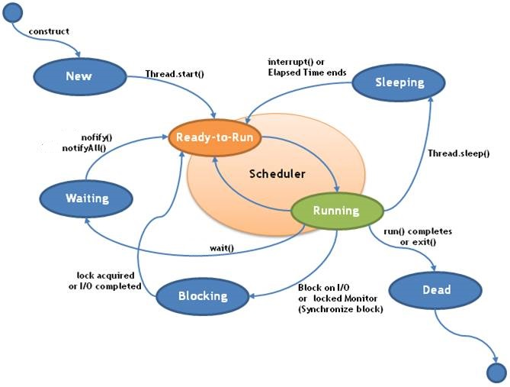
Life cycle of a Thread (Thread States)

Slide 2
Life cycle of a Thread (Thread States)
Once running, a thread may go back to the “Ready to Run” state when one of the following occurs:
Running
We must call the start() method in order to schedule the thread to begin running. It is this that puts a thread into the “Ready to Run” state. When the thread’s run() method is called, the thread goes into “Running” state. Note : Thread run() method will be called by the Scheduler
Ready-To-Run
A newly created Thread in Java will be in this state just after constructing but before calling the start() method.
New
the thread is blocking on some I/O
the object’s wait() method is called
thread’s yield() method is called
the allotted time slice ends (OS dependent)
thread’s sleep() method is called

Slide 3
Life cycle of a Thread (Thread States)
Waiting
A Running thread will go into a waiting state when an object’s wait() method is called. This mechanism is used as a communication means between threads in order to avoid polling. Waiting threads are put into the object’s queue. When another thread associated with the object calls notify(), then the first thread in object’s wait queue go into “Ready-To-Run” state. If notifyAll() is called, then all threads in the object’s wait queue go into the “Ready-To-Run” state.
Sleeping
A Running thread will go into the “Sleeping” state when the thread.sleep() method is called. The thread goes back into the “Ready-To-Run” state after the specified time has elapsed or if interrupted.
Blocking
A Running thread enters a “Blocking” state when it requests some type of I/O and is waiting for the I/O to complete or become available. The thread goes back to “Ready-To-Run” state when the I/O becomes available.
A Running thread enters the “Dead” state when the condition is met such that it exits its run() method normally or completes normally.
Dead

